Slide 1
The Camera:
How it works.
Notes:
How Camera’s work: http://electronics.howstuffworks.com/camera.htm
How vision works: http://www.howstuffworks.com/eye.htm

Slide 2
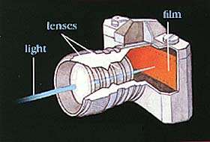
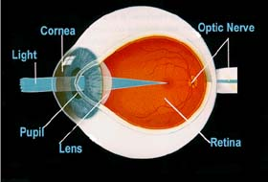
The human eye is like a camera.
The Camera
The Human Eye
Lens Cover = Cornea
Aperture = Iris and Pupil
Lens = Lens
Film = Retina
Notes:
http://www.pasadenaeye.com/faq/faq15/faq15_text.html
How Does The Human Eye Work?
The individual components of the eye work in a manner similar to a camera. Each part plays
a vital role in providing clear vision. So think of the eye as a camera with the cornea, behaving
much like a lens cover. As the eye's main focusing element, the cornea takes widely diverging
rays of light and bends them through the pupil, the dark, round opening in the center of the
colored iris. The iris and pupil act like the aperture of a camera.
Next in line is the lens which acts like the lens in a camera, helping to focus light to the back
of the eye. Note that the lens is the part which becomes cloudy and is removed during cataract
surgery to be replaced by an artificial implant nowadays.
The very back of the eye is lined with a layer called the retina which acts very much like the
film of the camera. The retina is a membrane containing photoreceptor nerve cells that lines
the inside back wall of the eye. The photoreceptor nerve cells of the retina change the light
rays into electrical impulses and send them through the optic nerve to the brain where an
image is perceived. The center 10% of the retina is called the macula. This is responsible for
your sharp vision, your reading vision. The peripheral retina is responsible for the peripheral
vision. As with the camera, if the "film" is bad in the eye (i.e. the retina), no matter how good
the rest of the eye is, you will not get a good picture.
The human eye is remarkable. It accommodates to changing lighting conditions and focuses
light rays originating from various distances from the eye. When all of the components of the
eye function properly, light is converted to impulses and conveyed to the brain where an
image is perceived.
http://www.aoa.org/x6024.xml

Slide 3
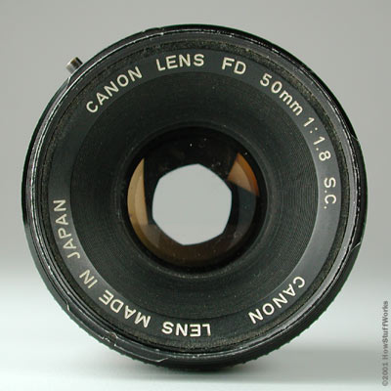
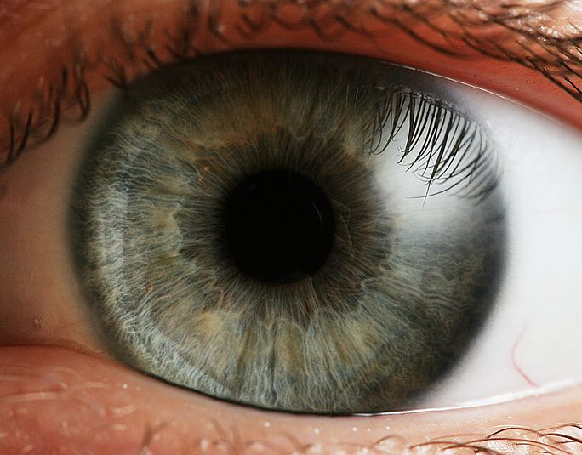
Try to make your eyes dilate.

Slide 4
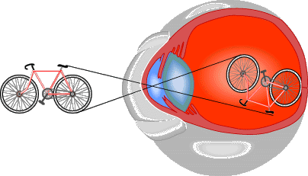
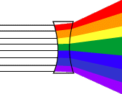
Refraction in the eye.
Objects look smaller.
Objects look bigger.

Slide 5
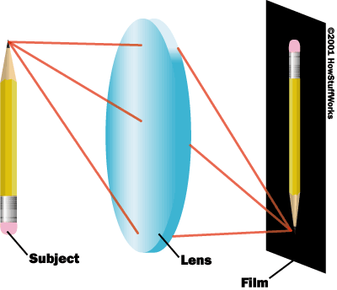
Same in the camera lens.

Slide 6
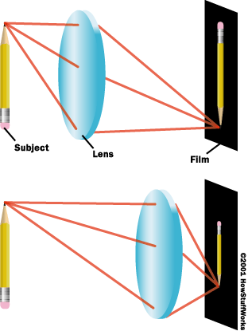
Distance from the object.

Slide 7
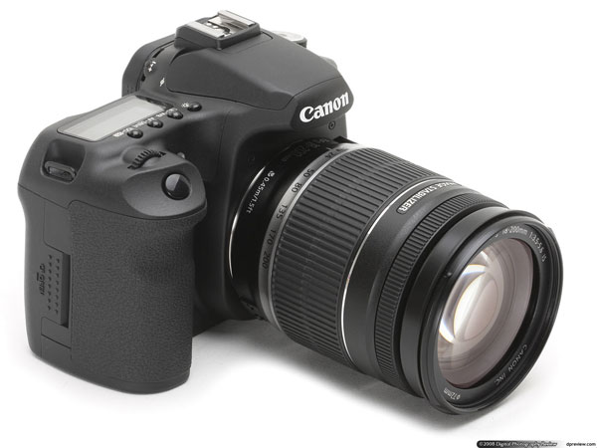

Slide 8
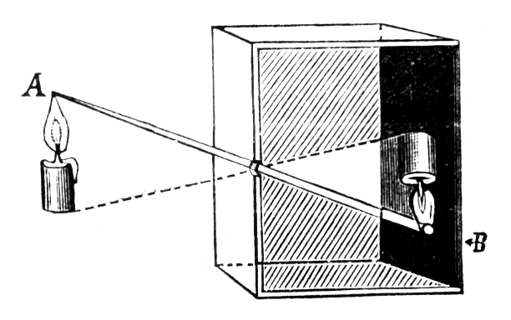
Camera Obscura
Notes:
Hundreds of years ago, artists discovered the camera obscura. They noticed that light coming through a keyhole into a dark room cast an inverted image on the wall. They built a camera obscura by setting a lens into a two-foot square box and placing a sheet of glass opposite the opening. With the camera obscura in hand, the artist could set up the equipment in the field. Through the camera frame, the artist saw the view that he or she wished to draw. Then the artist traced the image reflected on the glass frame with a high degree of detail. In this way, artists used an early form of a camera picture to give their drawings realistic perspective and detail.

Slide 9
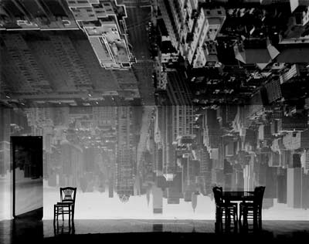
Abelardo Morell
The Camera Obscura (Latin for Dark room) was a dark box or room with a hole in one end. If the hole was small enough, an inverted image would be seen on the opposite wall.
- A History of Photography - Camera Obscura

Slide 10
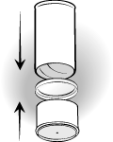
How to make a Camera Obscura…
Rolled black board
Rolled black board
Wax paper
Tiny hole made with a sharp pencil.
Tin foil
Notes:
http://www.exploratorium.edu/science_explorer/pringles_pinhole.html
http://www.ehow.com/how_4450643_make-camera-obscura.html
http://ltc.smm.org/makeit/node/346

Slide 11
Fold your paper into 6 equal spaces and answer these reflection questions:
What do you observe about the image when looking through your camera obscura? | Why did we use wax paper instead of glass?
What else can a camera obscura be made out of? (provide one example and explain how you would do it.) | What was significant about the camera obscura invention?
What other types of technology do you think the camera obscura lead to? | How does the size of the holes we made in the tin foil relate to the way the aperture works on the camera?

